Slide 1


Mengenal C++ Pertemuan ke 2
Pertemuan 1
02-09-2023
Herlambang Rizky - 085719431120

Slide 2


C++ 2nd Class subject
Identifier
Refrence in C++
Different between refrence and assignment
Variable Properties in C++
Type Qualifier
Operator in C++
Selection in C++
Looping

Slide 3

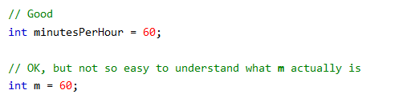
1. Identifier in C++
In C++ programming language, identifiers are the unique names assigned to variables, functions, classes, structs, or other entities within the program. With this concept, programmer can easly understand the use of specific variable. Here is the example :

Slide 4
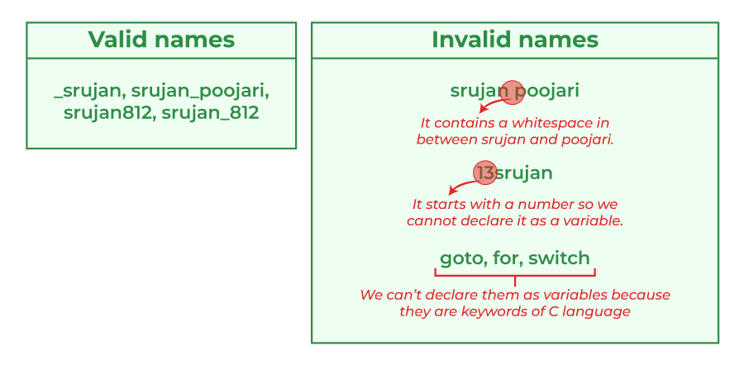
Identifier in C++ Cont..
And this is general rule for naming variable :
Names can contain letters, digits and underscores
Names must begin with a letter or an underscore (_)
Names are case sensitive (myVar and myvar are different variables)
Names cannot contain whitespaces or special characters like !, #, %, etc.
Reserved words (like C++ keywords, such as int) cannot be used as names
Additionally, C++ is a case-sensitive language so the identifier such as Num and num are treated as different.

Slide 5

2. Refrence in C++
A reference variable is like a nickname for an existing variable. Once it's set, we can't change it to point to something else. We must give it a value when you create it, and it can't be empty. To make a reference variable, we use the '&' symbol. This is the following syntax of refrence variable :

Slide 6

Refrence in C++ Cont..
Here is the detail explaination of structure before :
datatype − The datatype of variable like int, char, float etc.
variable_name − This is the name of variable given by user.
refer_var − The name of reference variable.

Slide 7
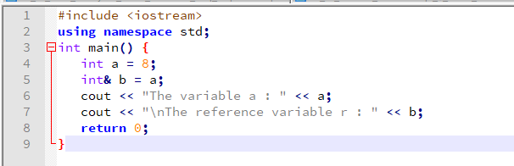
Refrence C++ - Sample Code
Please run and debug this code, and give explaination about each code below

Slide 8
3. Different between refrence and assignment in C++
In C++, references and assignment of values are two distinct concepts with different purposes and behaviors.
Assigment Value :
Assignment of values involves copying the value from one variable to another. When we assign a value, we create a separate copy of the data.
The original variable and the variable receiving the assigned value are independent of each other. Changes to one do not affect the other.

Slide 9


Different between refrence and assignment in C++
Sample Code for Assigment:
Please give proper explaination about each line of the code below

Slide 10
Different between refrence and assignment in C++
In C++, references and assignment of values are two distinct concepts with different purposes and behaviors.
Refrence Value :
A reference in C++ is essentially an alias or an alternative name for an existing variable.
When we create a reference, it doesn't allocate new memory or store a separate copy of the value. Instead, it points directly to the memory location of the variable it references.
Changes made to the reference variable affect the original variable and vice versa because they share the same memory location.
References are typically used for function parameters (pass by reference) and for creating convenient aliases to existing variables.

Slide 11


Different between refrence and assignment in C++
Sample Code for Refrence:
Please give proper explaination about each line of the code below

Slide 12
Different between refrence and assignment in C++ - summary
In summary, references create a connection between two variables, allowing them to share the same data, while assignment of values creates separate copies of the data, making the variables independent. The choice between using references or assignment depends on your specific programming needs and whether you want variables to share data or have their own separate values.

Slide 13
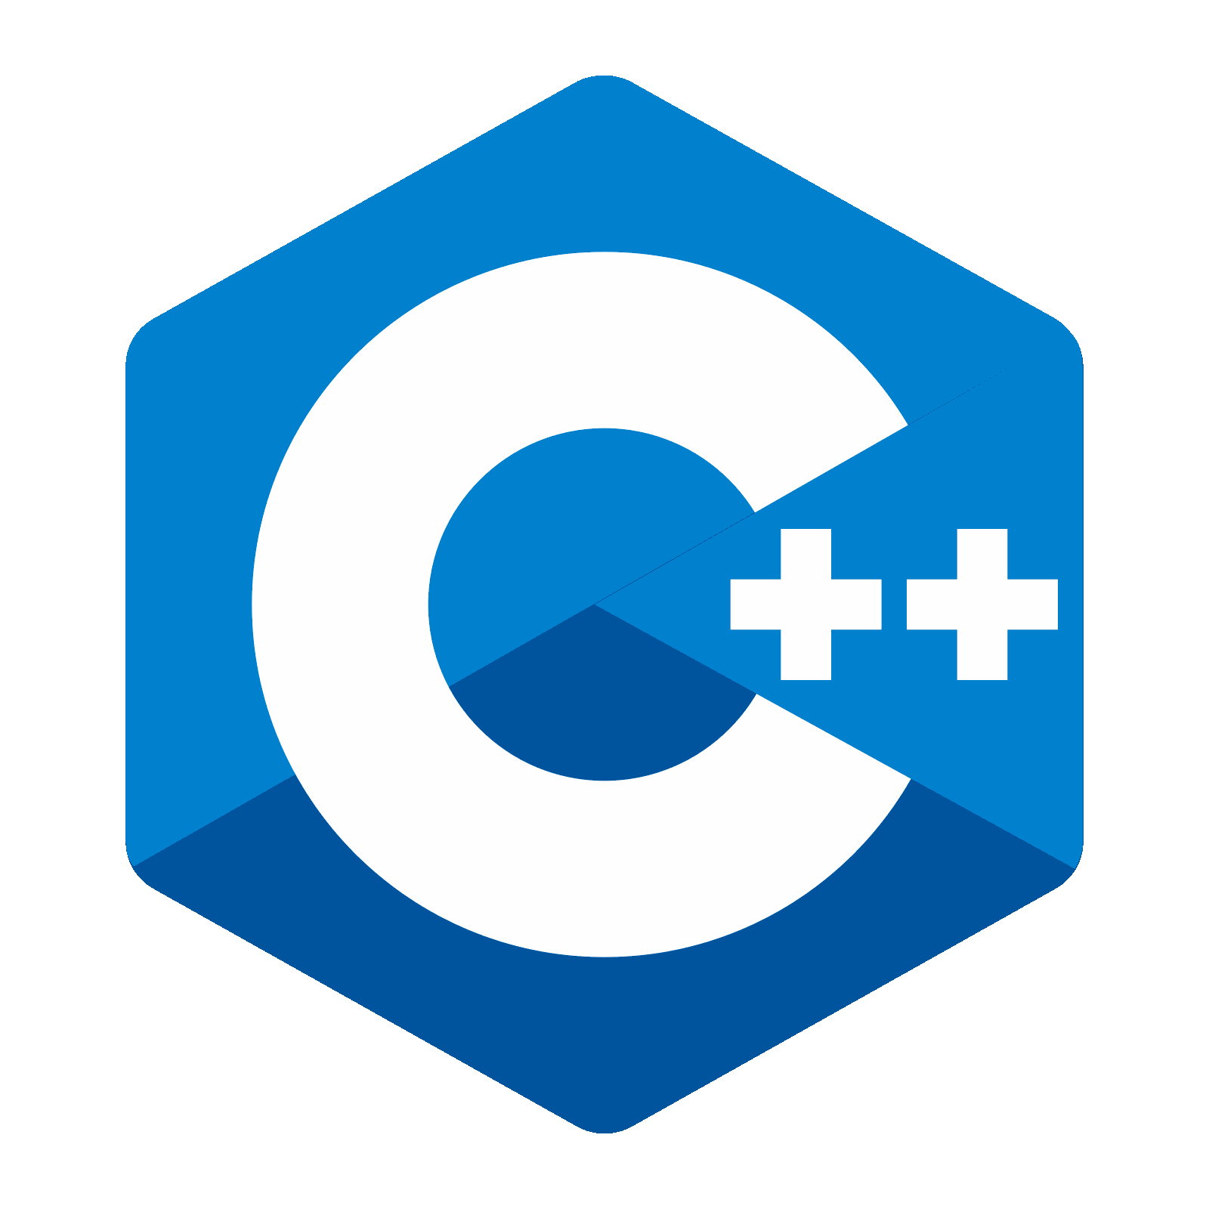
4. Variable Properties in C++
Variable properties are typically associated with objects or classes and provide a way to control access to the underlying data associated with those objects. In C++, you can achieve similar functionality using member functions (methods) to encapsulate and manipulate the data associated with an object. This encapsulation allows you to control access to the data and enforce certain behaviors when getting or setting the data.

Slide 14
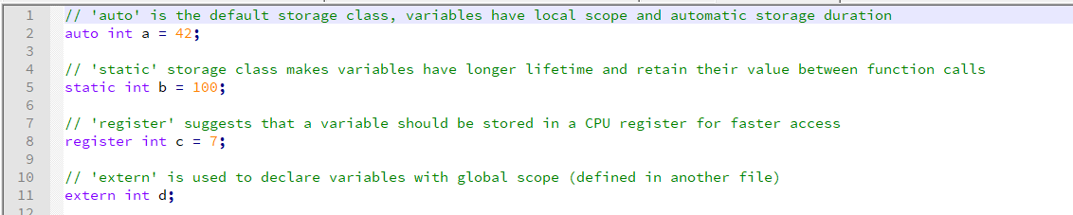
Variable Properties in C++ - Cont..
Storage Class
Storage class specifiers determine how long a variable exists in memory and its visibility.
Please give proper explaination about this code

Slide 15
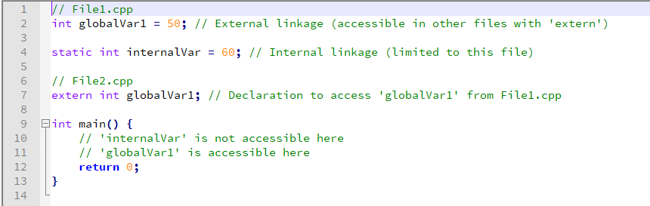
Variable Properties in C++ - Cont..
Linkage
Linkage determines whether a variable can be accessed across multiple source files.
Please give proper explaination about this code

Slide 16
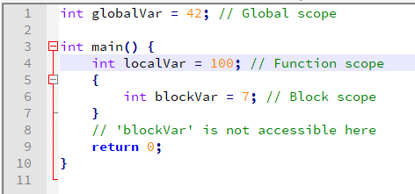
Variable Properties in C++ - Cont..
Scope
Scope defines where a variable can be accessed within a program.
Please give proper explaination about this code

Slide 17

5. Type Qualifier in C++
In C++, a type qualifier is a keyword used to modify the behavior of a variable's data type. There are two primary type qualifiers:
- const and volatile.

Slide 18

Type Qualifier in C++ - Cont..
Cons
The const type qualifier indicates that a variable's value cannot be changed after it's initialized. It is used to create constants or read-only variables.

Slide 19
Type Qualifier in C++ - Cont ..
Volatile
The volatile type qualifier tells the compiler that a variable's value may change at any time, even if it appears not to be modified within the code. It is often used for variables that can be modified by external factors, such as hardware or interrupt service routines.

Slide 20

Type Qualifier in C++ - summary
These type qualifiers help improve code correctness and readability by explicitly specifying whether a variable can change or not, and whether the compiler should make optimizations that assume variables won't change.

Slide 21
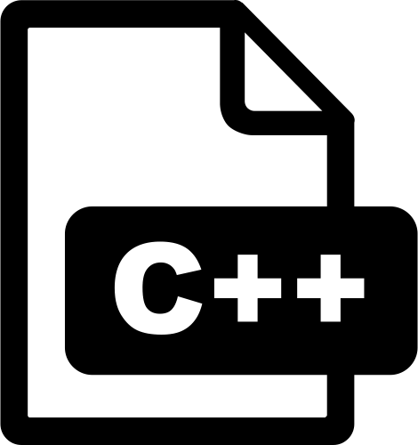
6. Operator in C++
Operators in C++ are symbols or special keywords used to perform operations on data or variables. They enable you to manipulate values, compare them, and perform various tasks within your C++ programs. Operators are a fundamental part of the language and are used extensively in expressions and statements. Here is some comprehensive example of this subject :

Slide 22
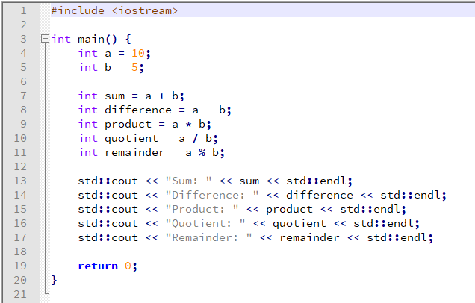
Operator in C++ - Cont..
Arithmetic Operator
Used to perform mathematical operation in c++

Slide 23
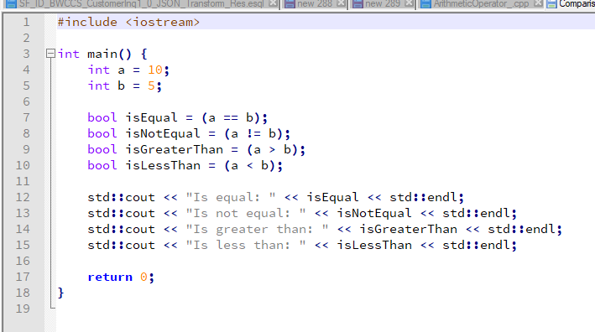
Operator in C++ - Cont..
Comparison Operator
Used to perform Comparison operators compare two values and return a boolean result (true or false).

Slide 24
Operator in C++ - Cont..
Logical Operator
Logical operators combine boolean values.
Operator | Desc | Example | Result
&& | AND | bool result1 = A && B; | true if both A and B are true, otherwise false.
|| | OR | bool result2 = A || B; | If one of value true so the result is true, but if all contains false so the result will generate false
! | NOT | bool result3 = !A; | true if A is false, and false if A is true

Slide 25
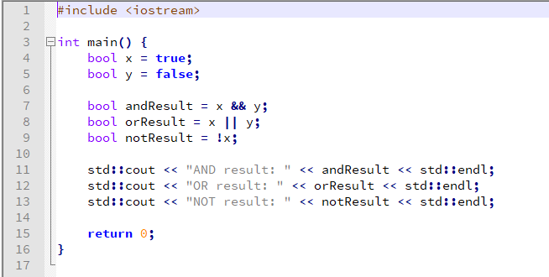
Operator in C++ - Cont..
Logical Operator
Sample code :
These operators are often used in conditional statements and expressions to make decisions based on the truth or falsehood of certain conditions.

Slide 26
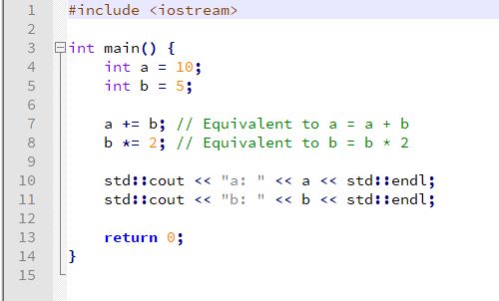
Operator in C++ - Cont..
Assignment Operator
Assignment operators assign values to variables.

Slide 27
7. Selection in C++
selection structures are used to make decisions in your program based on certain conditions. The most common selection structures are if, else if, and else also with switch and case.
[img]

Slide 28
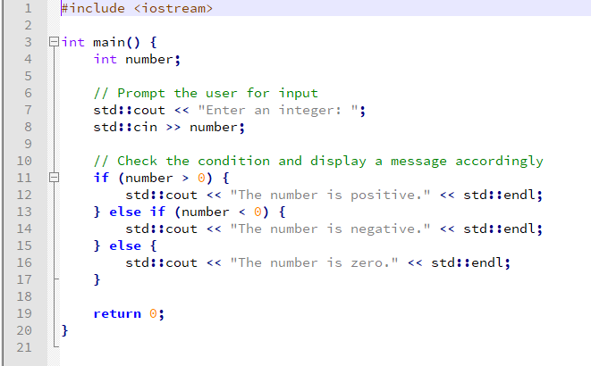
7. Selection in C++ - Cont..
If-else

Slide 29
7. Selection in C++ - Cont ..
Based on sample code before :
Explanation :
We declare an integer variable number to store the user's input.
We use std::cout to display a message asking the user to enter an integer, and we use std::cin to read the user's input into the number variable.
We use the if, else if, and else selection structures to check the value of number and display an appropriate message:
If number is greater than 0, it's considered positive.
If number is less than 0, it's considered negative.
If number is neither greater than nor less than 0, it's considered zero.
Depending on the condition met, the corresponding message is displayed.

Slide 30
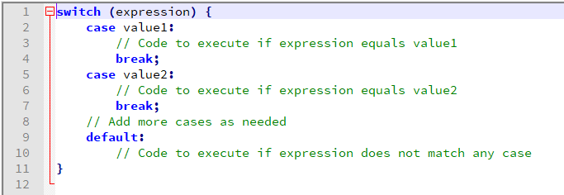
7. Selection in C++ - Cont ..
Switch
the switch statement is used to make decisions based on the value of an expression. It allows you to select one of several code blocks to be executed, depending on the value of the expression. The switch statement is often used when you have multiple cases to evaluate against a single value.

Slide 31
7. Selection in C++ - Cont ..
Switch
The expression is evaluated, and its value is compared with each case value.
When a case value matches the expression, the code inside that case block is executed.
The break statement is used to exit the switch block after a case is executed. Without break, execution would continue into the next case.
If none of the case values match the expression, the code inside the default block is executed (if a default block is provided).

Slide 32
7. Selection in C++ - Cont ..
Switch
Sampel Code : Refer to : switchSample2_.cpp
Code explain :
We declare an integer variable day to store the user's input.
We prompt the user to enter a number representing a day of the week and read the input into the day variable.
We use the switch statement to evaluate the value of day. Depending on the value, one of the case blocks is executed.
If the value of day matches one of the case values (e.g., 1, 2, 3, etc.), the corresponding day of the week is printed.
If day doesn't match any of the case values, the default block is executed, displaying an error message.
The switch statement is a convenient way to handle multiple conditional cases based on the value of an expression.

Slide 33

8. Looping in C++
In C++, looping allows you to repeatedly execute a block of code as long as a certain condition is true. There are primarily two types of loops in C++: the while loop and the for loop.

Slide 34
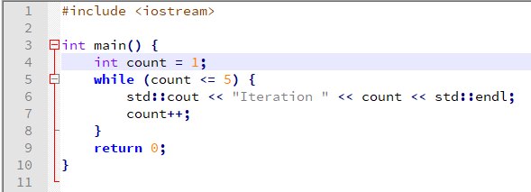
8. Looping in C++ - Cont ..
While
The while loop executes a block of code as long as a specified condition is true.
Explanation :
In this example, the code inside the while loop is executed as long as count is less than or equal to 5. count is incremented in each iteration.

Slide 35
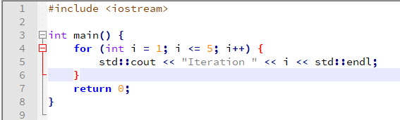
8. Looping in C++ - Cont ..
For
The for loop is designed to repeatedly execute a block of code for a specific number of times.
Explanation :
the for loop is used to iterate from i equal to 1 up to i equal to 5, and the code inside the loop is executed in each iteration.

Slide 36
8. Looping in C++ - Cont ..
For
The for loop is designed to repeatedly execute a block of code for a specific number of times.
Explanation :
the for loop is used to iterate from i equal to 1 up to i equal to 5, and the code inside the loop is executed in each iteration.

Slide 37
8. Looping in C++ - Cont ..
These loops are essential for controlling the flow of your programs and automating repetitive tasks. They allow you to execute code multiple times, making your programs more efficient and versatile.

Slide 38
8. Looping in C++ - Cont ..
Do-while
the do-while loop is another type of loop that allows you to repeatedly execute a block of code as long as a specified condition is true. Unlike the while loop, the do-while loop guarantees that the block of code is executed at least once before checking the condition.

Slide 39
8. Looping in C++ - Cont ..
Do-while
The do-while loop consists of:
The do keyword, followed by a block of code enclosed in curly braces { }.
The while keyword, followed by a condition, and a semicolon ;.
The block of code inside the do-while loop is executed once, and then the condition is checked.
If the condition is true, the block of code is executed again, and this process continues until the condition becomes false.

Slide 40
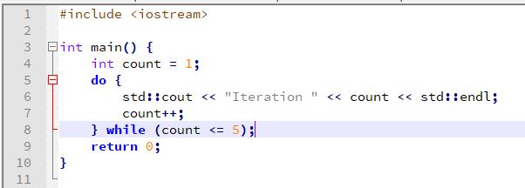
8. Looping in C++ - Cont ..
Do-while

Slide 41
Looping in C++ - Cont ..
Code Explanation :
In this example, the do-while loop is used to repeatedly print "Iteration" along with the current value of count.
The initial value of count is 1, and the loop executes at least once.
After each iteration, count is incremented, and the condition count <= 5 is checked.
As long as count is less than or equal to 5, the loop continues to execute. Once count becomes 6, the condition becomes false, and the loop terminates.

Slide 42
Looping in C++ - Cont ..
The do-while loop is useful when you need to ensure that a specific block of code runs at least once, even if the condition is initially false. It's a valuable tool for various programming scenarios, such as input validation and menu-driven programs.

Slide 43
Exercise
Print Numbers: Write a program that uses a for loop to print numbers from 1 to 10.
Even Numbers: Modify the program to print even numbers from 2 to 20.
Countdown: Write a program that counts down from 10 to 1 using a while loop.
Sum of Numbers: Calculate the sum of all numbers from 1 to 100 using a for loop.

Slide 44
Exercise
Even & ODD number : Write a program that checks if a number entered by the user is even or odd and prints the result.
Positive or Negative: Create a program that determines whether a number is positive, negative, or zero.
Day of the Week: Write a program that takes an integer from 1 to 7 as input and prints the corresponding day of the week. Ex : 1 is Monday

Slide 45
Exercise
Arithmetic Operators: Write a program that takes two numbers as input and performs addition, subtraction, multiplication, and division operations on them.
Increment and Decrement: Create a program that demonstrates the use of the increment (++) and decrement (--) operators.
Comparison Operators: Write a program that takes two numbers as input and compares them using the equality (==), greater than (>), and less than (<) operators.
Logical Operators: Create a program that checks if a given number is between 10 and 20 (inclusive) using logical operators (&& and ||).

Slide 46
Repo
Bit.ly/DriveTugas_CPP2023
https://bit.ly/BinusCPP2023
Branch : Materi
Branch : Tugas
Branch : Sample

